Slide 1
Microservices in Azure
How Microsoft's public cloud supports modern application architecture
Doug Vanderweide, MCSE, MCSD, MCT
https://www.dougv.com @dougvdotcom linkedin.com/in/dougvdotcom

Slide 2
Today's objectives
Define
"microservices," "SOA" and other terms
Understand
the architecture of a microservices-based application
Discover
the base services Azure provides to support that pattern
Describe
supporting services used alongside those base services
Review
metrics and monitoring options

Slide 3
What Are Microservices, Really?
Or 'Service-Oriented Architecture.' Or whatever the kids are calling it these days.

Slide 4

They're building blocks.

Slide 5

We can build simple structures from a few blocks,

Slide 6
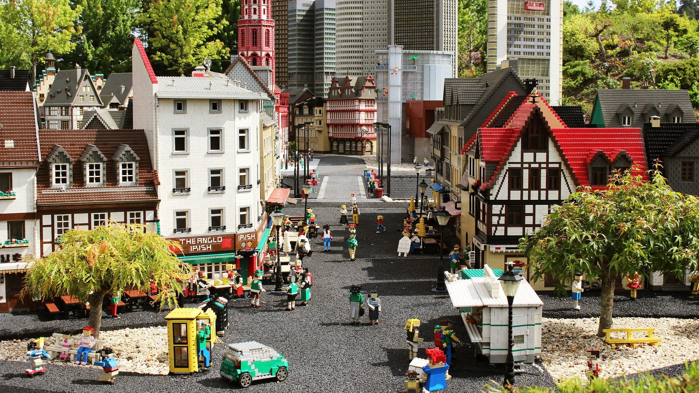
or very complex, integrated solutions from many blocks.

Slide 7
Service-Oriented Architecture
It’s just another way of saying "microservices"
Each service of an SOA/microservices-based solution:
does just one thing
is independently managed
can be reused by many different solutions
can be easily replaced by something else
adapts to its workload independently
communicates with its neighbors via standard protocols (HTTP, messages)

Slide 8
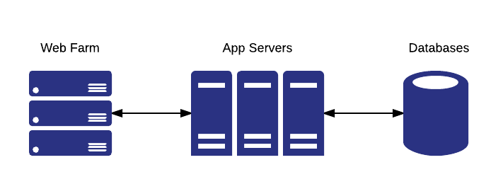
An n-Tier Web Application

Slide 9
Why This Doesn't Work Well In The Cloud
Cloud-based network services are more abstract
1
Monoliths are difficult to maintain and scale
2
Requires lots of server/network configuration and admin
3
Doesn't make full use of cloud abstractions
4

Slide 10

Microservices To The Rescue!

Slide 11
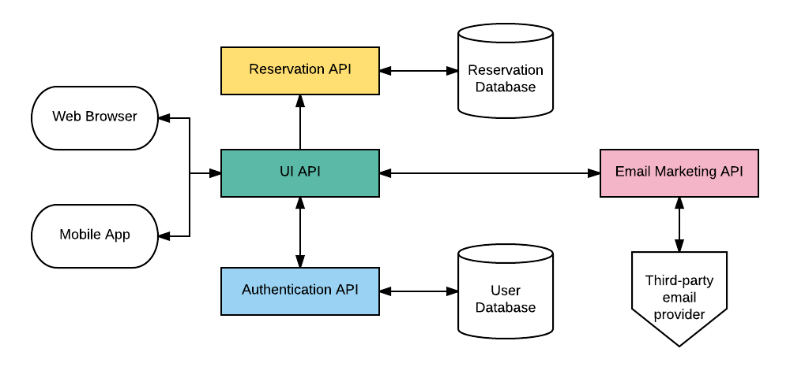
Microservices-Based Web Application

Slide 12
Benefits Of Microservices Architecture
Recycle APIs for other uses
e.g., reservations API can place waste inventory on discount sites
Manage each service independent of other services
Problem with the authentication API? Other services stay up while you fix it
Each service scales independently
High Web UI demand? Only scale that API
Allows continuous integration/continuous delivery/automation
No more sprints ruining your weekends
Check out a branch, test it, deploy it -- all via automation

Slide 13
Basic Azure PaaS Options
The public cloud services that host your underlying APIs/microservices

Slide 14
App Service
Azure Resource Manager's adoption of ASM Cloud Services
Web and Worker roles are now Web, API, Mobile, Logic or Function apps
Uses anonymous, generalized guest OS to host services
Windows and Linux
Azure handles most configuration and management
You have control over runtimes, some environment aspects

Slide 15
Web Apps
Used to host websites
Built for high availability
Multi-instance
Automatic load balancing/health probes
Can be scaled on a schedule or via metric
Meet anticipated or unanticipated demand
Built for CI/CD via git, VSTS, cloud file storage

Slide 16
Logic Apps
Used to chain together API workflows
Trigger event kicks off workflow
Workflow performs a task, using inputs
Process can be looped, building off each input
Incorporates common APIs, aka connectors
Twitter, Facebook, Google, YouTube, etc.
Available for most Microsoft and Azure SaaS workloads
Office 365, SQL Server, Dynamics, Power BI, OneDrive, etc.
Many other enterprise workloads available
Salesforce, Oracle, SAP, etc.

Slide 17
Mobile Apps
Intended to serve as the "back end" tooling
Effectively used to create API endpoints and data stores
Simplified management for offline data sync
SQL, NoSQL, Azure Storage
You can create your own data API, too
Used to manage push notifications (via Notification Hubs)
Provides easy SSO management
Azure Active Directory, Facebook, Twitter, Microsoft, Google

Slide 18
API Apps
Very similar to Web Apps
Adds Swagger-based API management tooling
Service discovery
Documentation
Access control / authentication

Slide 19
Containers
Isolating workloads to speed up deployments and improve reliability

Slide 20
What Are Containers?
Means of packaging software and services together
System libraries, tools, services, settings, runtime and code itself
Isolates its workload from other workloads on the host
Allows you to pack several workloads onto a single guest OS host
Provides repeatable results for multiple deployments
Tends to reduce deployment time and overhead
Build the container image, create multiple instances from that image
Tends to increase deployment tempo
Simplified testing, easy versioning

Slide 21
Azure Container Service
Azure fully supports Docker containers
Docker Swarm and Kubernetes
Support for Mesosphere
DC/OS and Marathon
Azure Container Registry support
Pull directly to Container Service, App Service, Batch, Service Fabric

Slide 22
Azure Service Fabric
Microsoft's proprietary distributed systems platform
Most Azure services are hosted on Service Fabric
SQL Database, Cosmos DB, IoT Hub, Dynamics 365, etc.
Container-based
Windows, Linux, "reliable actors"
Designed to host microservices
Stateless and stateful
Runs on Azure, on-prem and even other cloud providers
Dev environment matches production environment

Slide 23
Serverless
Azure's serverless technology, and the future of microservices

Slide 24
What Is Serverless?
Vendor manages all infrastructure aspects
Instances, instance size, patching, networking, availability, runtimes, etc.
You write code that can run in this predefined environment
You pay only for what you use
Number of executions
Amount of CPU and memory needed to perform the task

Slide 25
Functions
Azure's serverless solution
Backboned on Web Apps; effectively, they're supercharged WebJobs
Provisioned when needed, deallocated when not
Can be provisioned continuously, too
Works on trigger / input / output model
Something happens;
the function (optionally) retrieves some input;
and (usually) creates some output

Slide 26
Supporting Services
Microservice-based architectures still need state and storage

Slide 27
Database Options
Azure SQL Database
Similar to SQL Server RDBMS
Cosmos DB
NoSQL (MongoDB), document, graph, table Storage
Table Storage

Slide 28
Storage
Azure Files
SMB-based network shares
Azure Storage
Blobs, appends and page files

Slide 29
State Management
Service Bus
Messaging queue, topic queue, relay queue
Guaranteed FIFO and once-only delivery
Storage Queue

Slide 30
Cache And Key Storage
Azure CDN
Global distribution of static/cached files
Verizon Standard and Akamai Standard
Verizon Premium (includes robust rules engine)
Redis Cache
In-memory cache / transient storage
Azure Key Vault
HSM-backed storage of secrets and keys

Slide 31
High Availability
Azure Traffic Manager
DNS-based routing
Global Replication
Storage, Azure SQL Database, Cosmos DB, Azure Active Directory
Autoscaling
App Service
Functions
Container Host VMs (via metrics and VMSS)

Slide 32
Monitoring
Automation requires exceptional metrics

Slide 33
Application Insights
Application Performance Management service
Collects telemetry from .NET, Java and Node.JS-based applications
Focused on Web applications/HTTP-backed services
Most microservices are delivered via HTTP
Provides feedback on performance, latency, errors, etc.
Very low overhead; about as expensive as an HTTPS cookie
Can bridge multiple services and aggregate results
New feature, in preview
Can export metrics to Power BI, other receivers (via JSON)

Slide 34
Operations Management Suite (OMS)
Basically SCOM for Azure/the cloud
Monitor resources regardless of location (on-prem/hybrid/SaaS)
More useful for watching service health than application performance

Slide 35
Topology of the Demo

Slide 36
Image Sharing Solutions
Allows contributions via FTP
Mines Twitter for tweets with a certain hashtag
Allows API access to upload and retrieve images
Has a GUI so humans can moderate the content
Processes image resizing/processing asynchronously via Functions
Uses Service Bus messaging to coordinate workflows
Easily distributed in new regions for HA/BCDR
Kinda looks like n-tier when you look at how it works

Slide 37
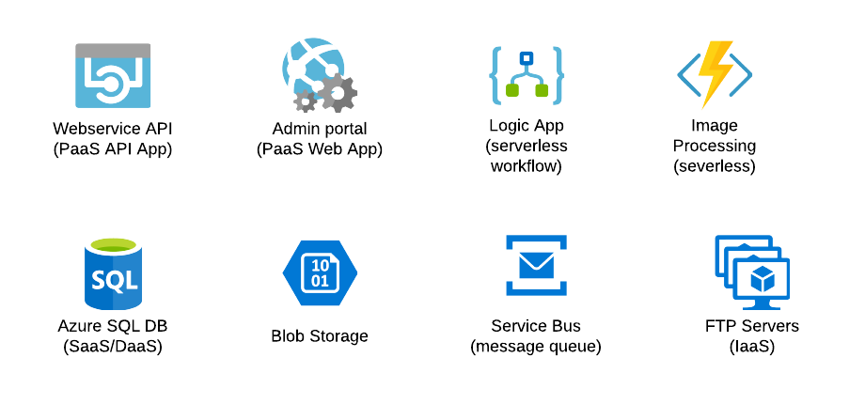
Components Used

Slide 38
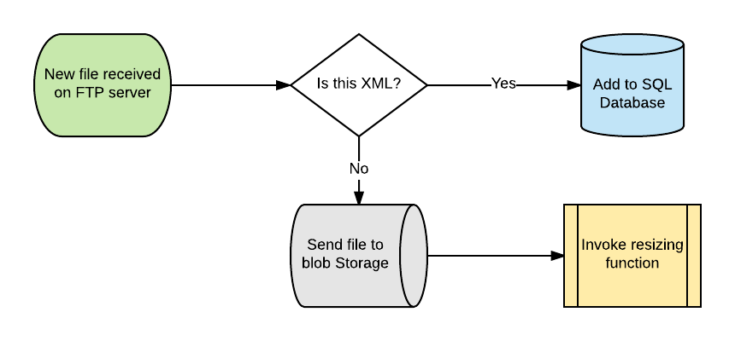
Workflow: FTP

Slide 39
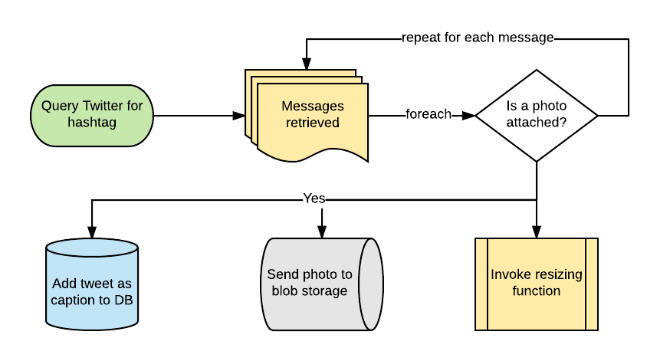
Workflow: Logic App

Slide 40
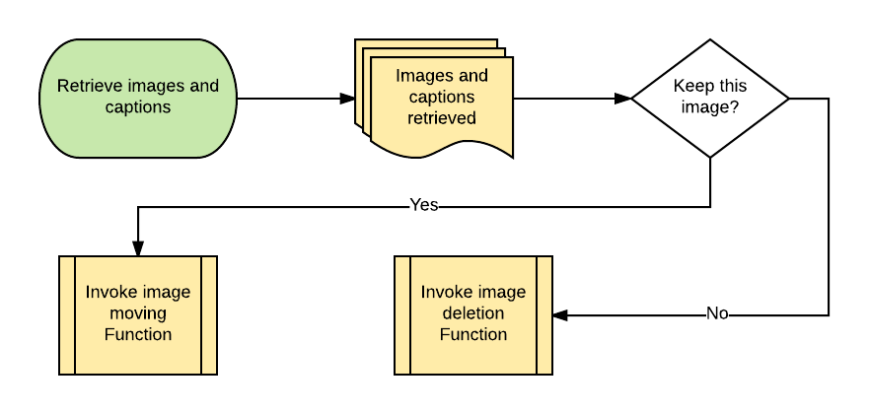
Workflow: Image Moderation

Slide 41
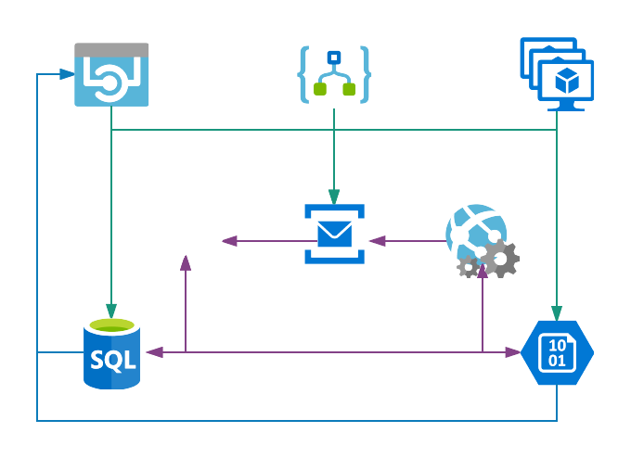
Solution Topology
Looks a lot like n-tier, doesn't it?

Slide 42
Demo Time!
A distributed system for managing photos from multiple sources

Slide 43
Questions? Ideas? Let's Share!
GitHub repo: https://github.com/dougvdotcom/ddnug-microservices
This deck on SlideShare: https://www.slideshare.net/DougVanderweide/microservices-in-azure-79777787
Doug Vanderweide
https://www.dougv.com
@dougvdotcom
linkedin.com/in/dougvdotcom
LinuxAcademy.com
CloudAssessments.com
Photos via pixabay.com

